Slide 1

Evaluation Of An Online Donation Platform
REVIEW 1
This Photo by Unknown Author is licensed under CC BY-SA

Slide 2
CONTENTS
1. INTRODUCTION TO PROJECT
2. SURVEY REPORT
3. DESIGN THINKING CONCEPTS
4. UNIQUE ADD-ON
5. PROTOTYPE & LINKS
6. CONCLUSION

Slide 3
INTRODUCTION TO PROJECT

Slide 4
Online Donation Platform
1. Scope: A digital platform enabling secure, transparent, and seamless donations for individuals and organizations, supporting one-time, recurring, and anonymous contributions.
2. Purpose: To simplify the donation process, ensure secure transactions, provide tax receipts, offer real-time impact updates, and support multiple payment methods.
3. Intended Audience:
Individuals donating to causes they care about, nonprofits & NGOs managing donations, corporates supporting CSR initiatives.

Slide 5

SURVEY REPORT
This Photo by Unknown Author is licensed under CC BY-NC-ND

Slide 6
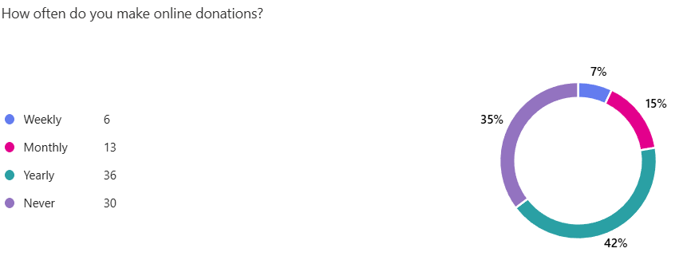
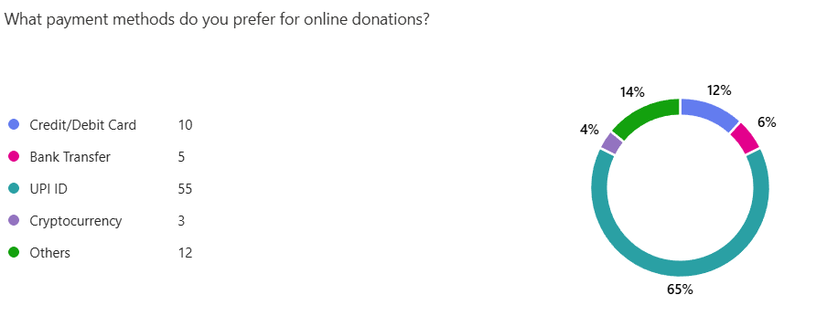
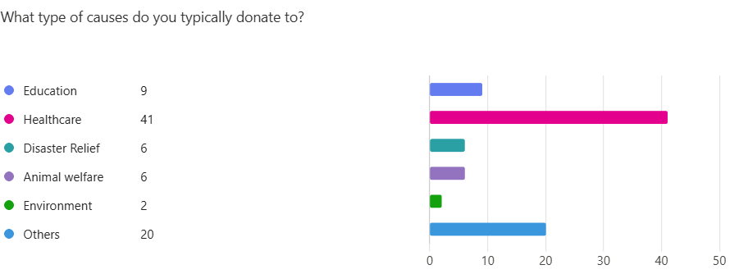
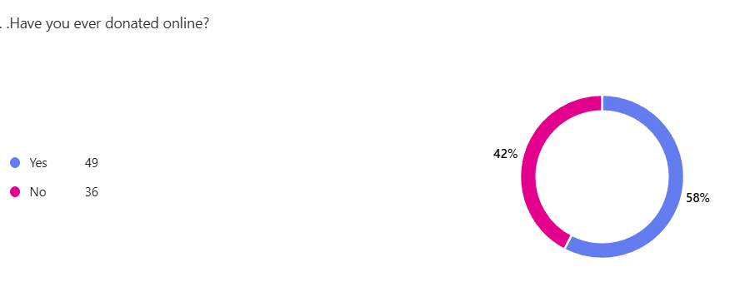

Slide 7
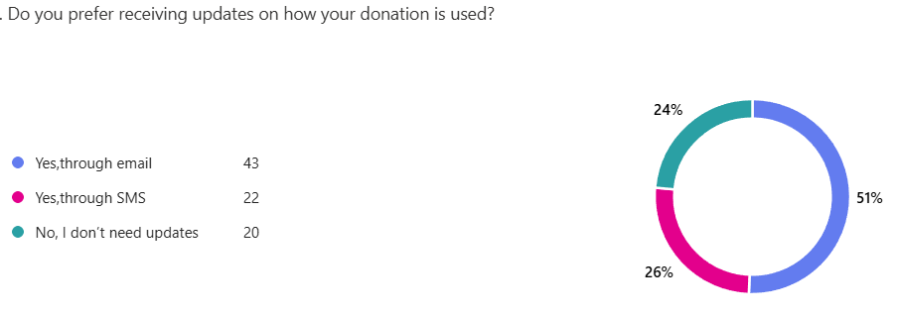
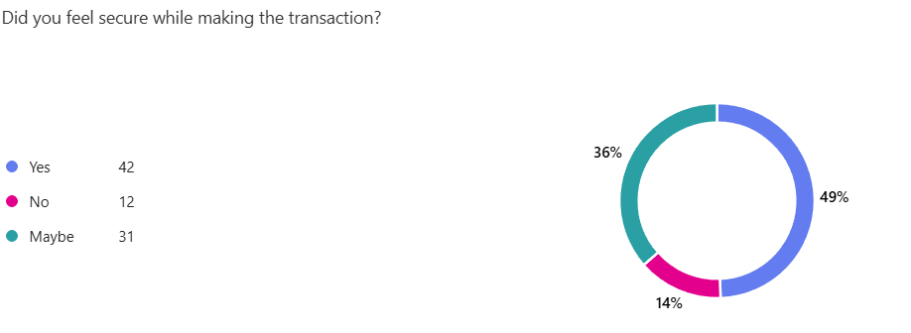
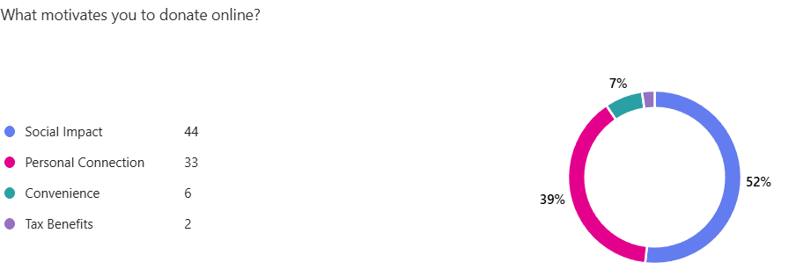
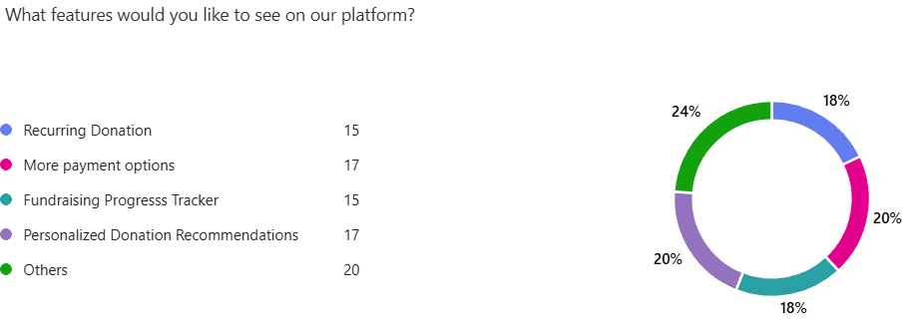

Slide 8
SURVEY SUMMARY
Have you ever donated online?
Majority have donated online before.
A few respondents have never donated online.
How often do you make online donations?
Most donors contribute yearly or monthly.
A small percentage have never donated online.
What type of causes do you typically donate to?
Popular causes include Healthcare and Education.
Some respondents support other causes as well.
What payment methods do you prefer for online donations?
Majority prefer UPI ID for transactions.
Some use other payment methods.
Did you feel secure while making the transaction?
Most respondents felt secure.
Some had mixed feelings or did not feel secure.
Suggestions for making the platform accessible to all age groups:
Multiple language support.
User-friendly interface with a simple and intuitive design.
Do you prefer receiving updates on how your donation is used?
Most prefer updates via SMS or email.
A few don’t require updates.
What motivates you to donate online?
Social Impact and Personal Connection are the key motivations.
What features would you like to see on our platform?
Personalized Donation Recommendations.
More payment options.
Recurring donation feature.

Slide 9

DESIGN THINKING CONCEPTS
This Photo by Unknown Author is licensed under CC BY-SA-NC

Slide 10
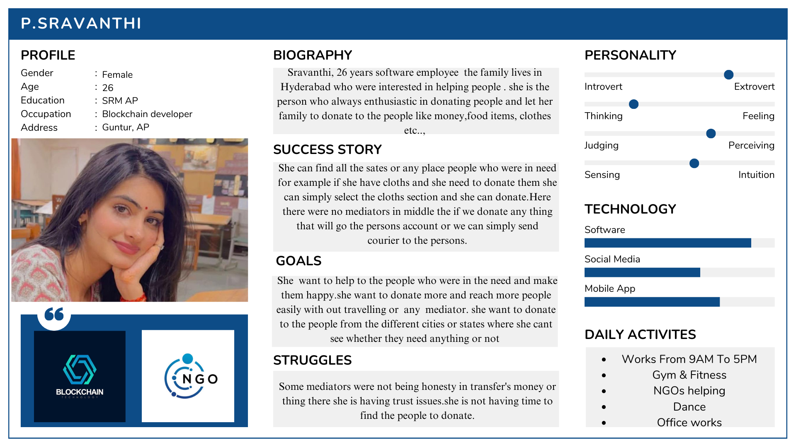

Slide 11
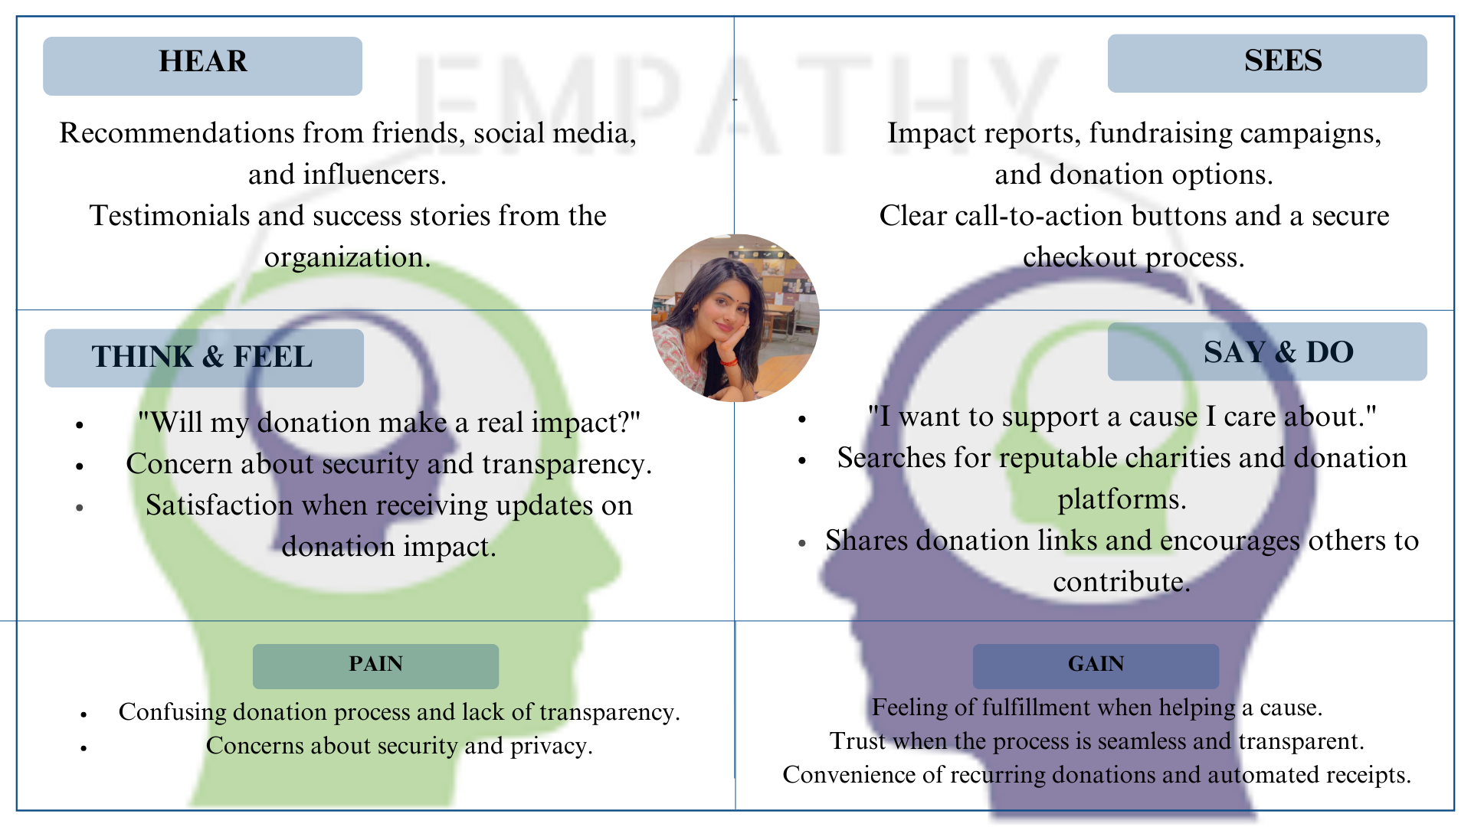

Slide 12
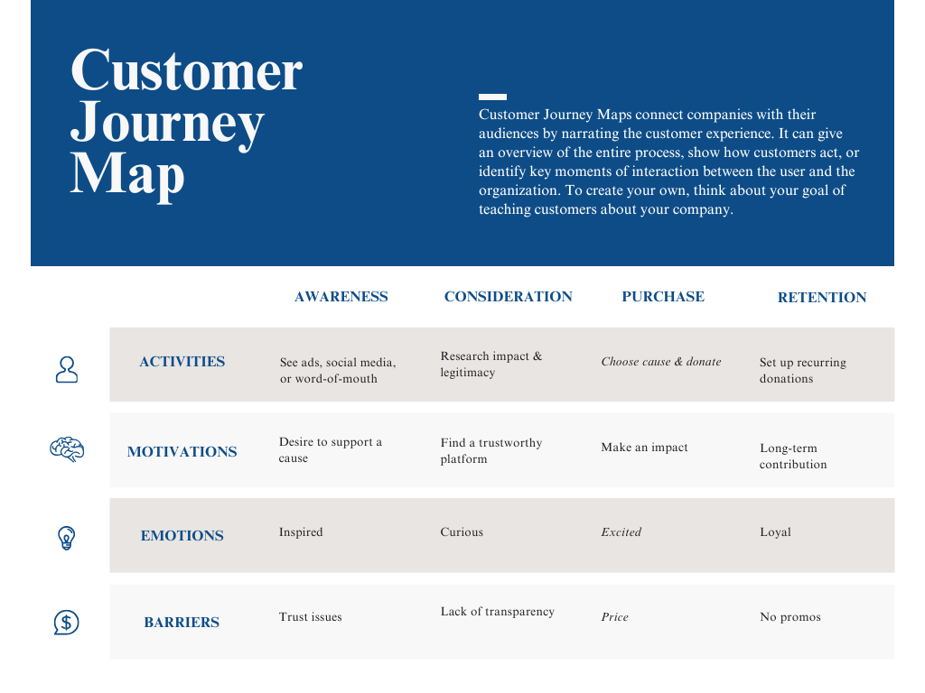

Slide 13

UNIQUE ADD-ON

Slide 14
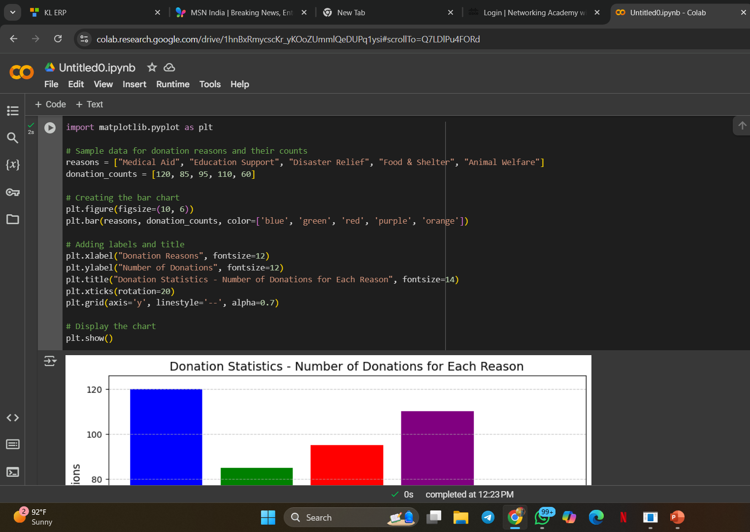
DONATION STATISTICS
-It shows the donations that are more on a particular day for a particular reason.

Slide 15
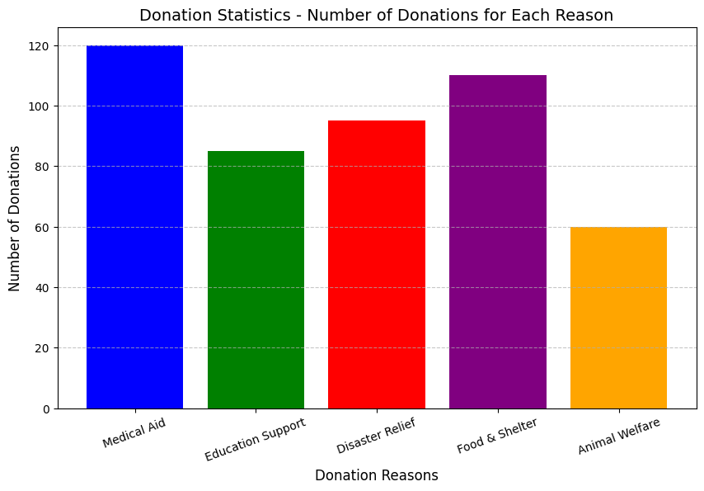

Slide 16

PROTOTYPE -LINKS

Slide 17
YOUTUBE LINK- https://youtu.be/HYnyxZ8Mm6Q?si=5y6j9ug0j3ZLatdm LINKEDIN ARTICLE LINK- https://www.linkedin.com/posts/n-sanjana-489b38333_activity-7295181887914872832-_BV_?utm_source=share&utm_medium=member_desktop&rcm=ACoAAFP-36kBcyXRgHFApWj5wqr8D7iv7H9xYOI PROTOTYPE LINK- https://www.figma.com/proto/8qZVhB2FdBNYCsXzz96Wk5/Humble-Hands-(Donation-Platform)?node-id=1-3&t=9jWqQEo2dW3ueLPs-0&scaling=min-zoom&content-scaling=fixed&page-id=0%3A1&starting-point-node-id=1%3A3

Slide 18
CONCLUSION

Slide 19

Developing an online donation platform using full-stack development provides a seamless and efficient way to facilitate charitable contributions. By integrating frontend technologies like React or Angular with backend frameworks such as Node.js, Django, or Spring Boot, organizations can create a responsive and secure system for donors. Key features like payment gateways, user authentication, and real-time analytics enhance the platform’s usability and trustworthiness.
Furthermore, implementing best practices in database management, security protocols, and UI/UX design ensures a smooth experience for both donors and administrators. As technology continues to evolve, incorporating AI-driven recommendations, blockchain for transparency, or mobile optimization can further enhance the platform’s effectiveness.
Overall, a well-designed full-stack donation platform can drive higher engagement, streamline fundraising efforts, and make charitable giving more accessible and impactful.
This Photo by Unknown Author is licensed under CC BY-NC-ND

Slide 20

THANKYOU

